Slide 1
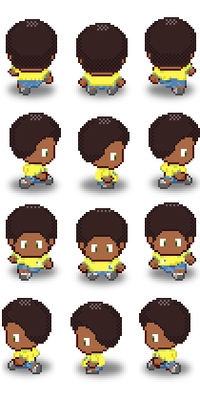
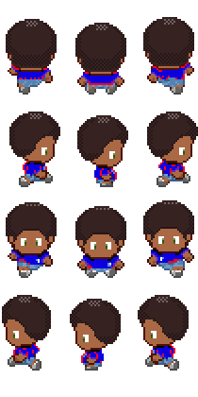

Soccer Stars
By Jose Hernandez & Edwin Portillo , Company: The Soccer Bros

Slide 2

SOCCER FIELD
*This Will Be Our Background*

Slide 3

SOCCER BALL & PLAYERS

Slide 4

HOW TO WIN
FACE OFF

Slide 5
SOCCER STARS
BY EDWIN PORTILLO AND JOSE HERNANDEZ
PRESS SPACE TO CONTINUE
THE SOCCER BROS INC.
LOADING...

Slide 6
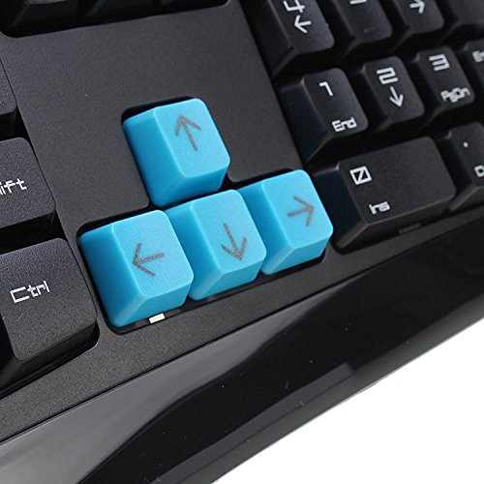

Soccer Stars
By Jose Hernandez & Edwin Portillo , Company : The Soccer Bros
KEYS: PLAYER: 1
= UP = LEFT
= DOWN = RIGHT
KEYS: PLAYER: 2
W = UP A = LEFT
S = DOWN D = RIGHT
PRESS SPACE TO BEGIN GAME

Slide 7

Soccer Stars
By Jose Hernandez & Edwin Portillo , Company : The Soccer Bros
*Collect as much soccer ball as you can
Avoid the Referee to not lose points
20 points
- 20 points
PRESS SPACE TO BEGIN GAME

Slide 8
Score: 10
Time: 50
Score: 10

Slide 9
Score: 10
Time: 50
Score: 10

Slide 10
Score: 10
Time: 50
Score: 10

Slide 11

PRESS SPACE TO EXIT

